Slide 1

AI Air Quality Analysis and Environmental Monitoring System
Graduation Project – DEPI (AI & Data Science Track)
Presented by: Hassan Bassiouny-Ziad Meshref-Youssef Menisy-Malak Abdo Ramadan
Notes:
1

Slide 2
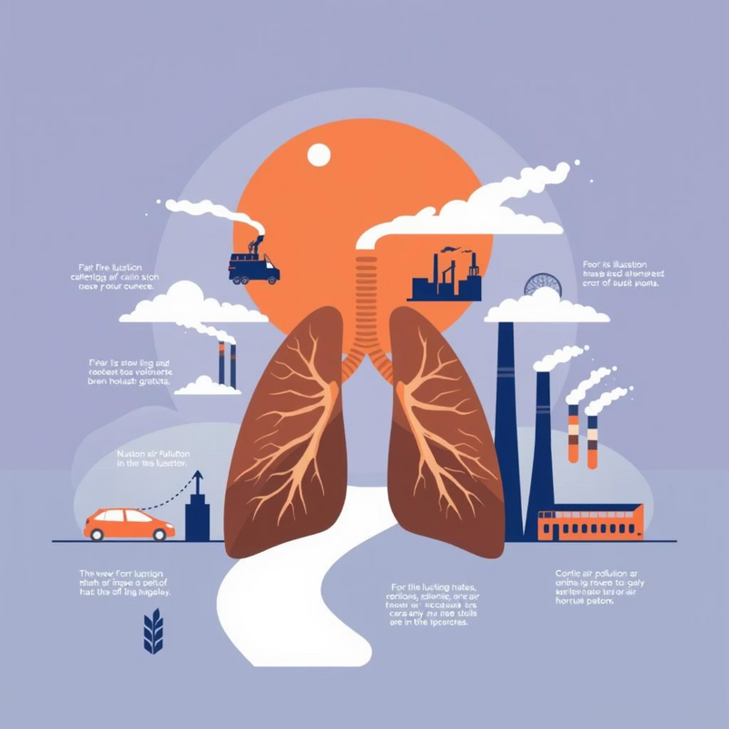
Air Pollution in Egypt: A Growing Concern
Air pollution in Egypt, particularly in urban centers like Cairo, presents a complex challenge due to rapid urbanization and high population density. Key contributing factors include:
Traffic: Aging vehicles release significant emissions (nitrogen oxides, carbon monoxide, particulate matter).
Industry: Factories (cement, textiles) discharge untreated pollutants (sulfur dioxide, heavy metals).
Dust Storms: Seasonal Khamasin winds drastically increase airborne particulate matter.
Waste Burning: Open burning, including the "black cloud" phenomenon, releases greenhouse gases and toxic compounds.
Energy Production: Fossil fuel power plants contribute to greenhouse gases and particulate matter.
This pollution leads to a profound public health crisis, causing a rise in respiratory and cardiovascular diseases, lung cancer, and premature deaths. Vulnerable populations, especially children, face heightened risks and cognitive development impacts. The World Health Organization estimates thousands of premature deaths annually in Egypt.
Economically, the crisis results in high healthcare costs, lost productivity, decreased agricultural yields, and negatively impacts tourism and ecosystems.
Notes:
2

Slide 3
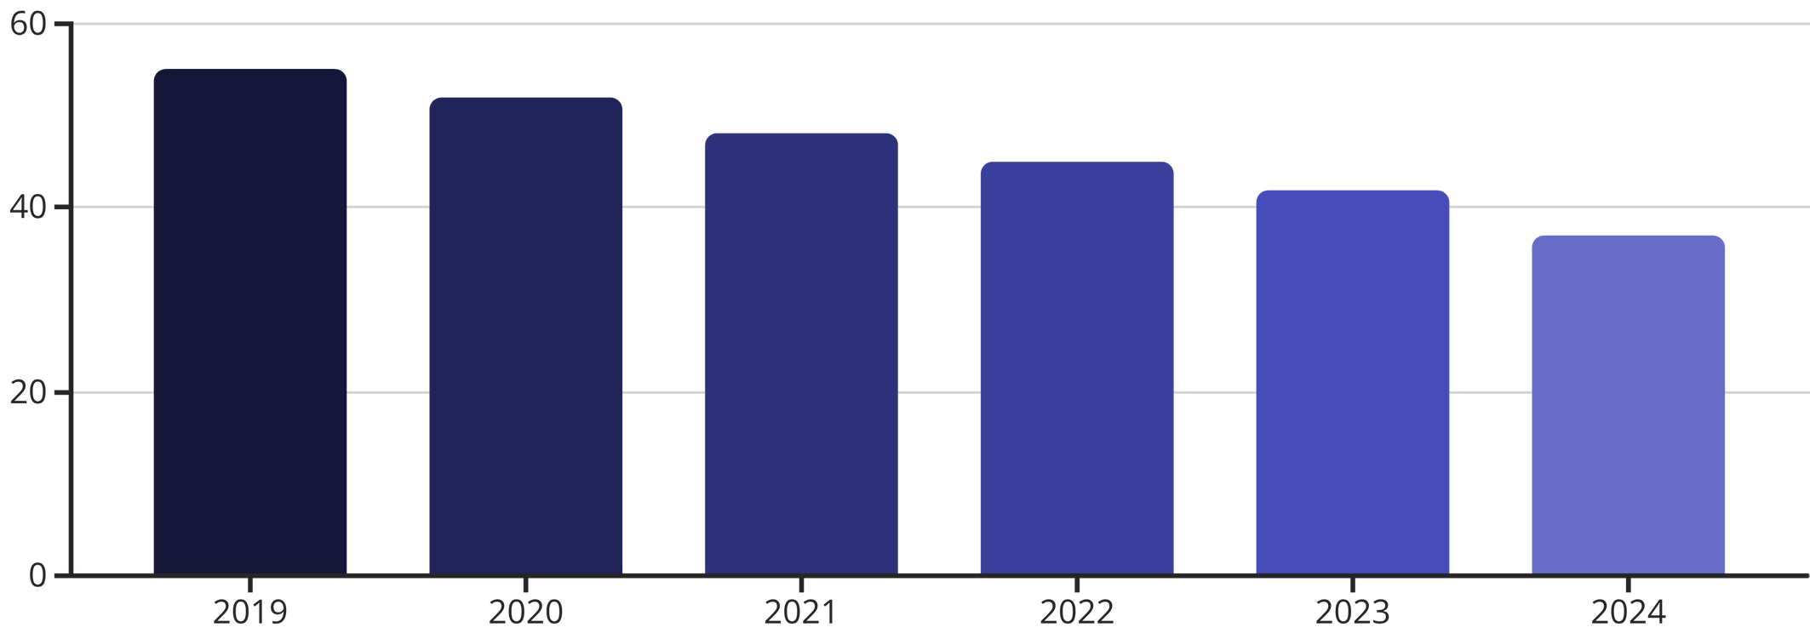
Recent Air Quality Improvements in Egypt
Through concerted efforts, Egypt has begun to turn the tide on air pollution. Recent governmental initiatives have yielded encouraging results:
Cleaner Fuels: Promotion of cleaner-burning fuels reduces harmful emissions.
Reduced Crop Burning: Strict regulations aim to minimize agricultural fires.
Electric Public Transport: Investment in sustainable transportation lessens urban pollution.
Stricter Emission Standards: Enforcement of higher standards for industrial and vehicular emissions.
These measures have led to a noticeable reduction in PM2.5 levels across urban regions, with Cairo's PM2.5 concentrations decreasing by an estimated 12% in the past year.
Notes:
3

Slide 4
Egypt's Air Quality Journey: 2024 Milestones and 2025 Vision
Our dedicated efforts in environmental policy and advanced monitoring are yielding tangible results, setting a clear path for a healthier future.
2024: Demonstrable Progress
2025: Ambitious Projections & AI-Driven Foresight
Building on previous initiatives, 2024 data reveals significant strides in mitigating air pollution. Our AI-powered monitoring system has been instrumental in providing real-time, granular insights, confirming the effectiveness of implemented policies.
Leveraging the robust data from our AI monitoring system, we project accelerated improvements for 2025. Our commitment to green policies, coupled with AI-driven optimization, promises a cleaner urban environment.
PM2.5 Levels in Cairo: A notable reduction to 37 µg/m³, reflecting a 12% decrease from 2023 levels (42 µg/m³). This surpasses initial targets, moving us closer to WHO interim guidelines.
Further PM2.5 Reduction: We anticipate an additional 5-7% decrease in average PM2.5 concentrations across major urban centers, pushing levels towards the 30-32 µg/m³ range. This will be primarily driven by the full implementation of new industrial emission caps and renewable energy projects.
Improved AQI Metrics: The number of "hazardous" Air Quality Index (AQI) days in Cairo has seen a significant drop from an average of 225 to 190 days annually. Our AI system's predictive analytics have helped pinpoint high-risk zones, allowing for targeted interventions.
Enhanced AQI & Public Health: Targeted interventions, informed by our AI system's scenario modeling, aim to reduce "hazardous" AQI days by an additional 15%. This includes the widespread adoption of Euro 6 emission standards for vehicles and a substantial increase in electric public transport infrastructure.
These improvements underscore the immediate positive impact of our integrated environmental strategies and the precision offered by AI analytics.
The trajectory, guided by our comprehensive AI monitoring platform, points towards a healthier, more sustainable Egypt, with significant improvements in respiratory health and overall quality of life.
Notes:
4

Slide 5
Egypt's Vision for Environmental Excellence
Egypt is committed to a sustainable future, embedding ambitious environmental goals within its national Vision 2030. Our strategy leverages advanced technology, policy reform, and community engagement to foster a healthier, greener nation for generations to come.
Vision 2030 & Sustainable Development
Expanded Monitoring & AI Integration
Our long-term environmental roadmap is guided by Egypt's Vision 2030, targeting sustainable resource management, biodiversity conservation, and robust climate action, ensuring ecological balance and prosperity for future generations.
By 2030, we plan to expand our environmental monitoring network by 50%, integrating more AI-powered sensors across urban and industrial zones to provide real-time, comprehensive data for proactive environmental management and policy refinement.
Air Quality & Green City Initiatives
Renewable Energy & Health Outcomes
We aim to achieve a 25% further reduction in key air pollutants (PM2.5, SO2, NOx) by 2030, moving closer to WHO interim targets. This includes widespread adoption of green building standards, sustainable urban planning, and expansion of eco-friendly transport in major cities.
Our goal is to increase renewable energy's share in the national grid to over 40% by 2035, significantly reducing carbon emissions. These efforts are projected to lead to substantial improvements in public respiratory health and overall quality of life.
Notes:
5

Slide 6

Project Goal: AI Air Quality Analysis and Environmental Monitoring System
Our project aims to establish a robust, real-time IoT data pipeline designed to continuously monitor crucial environmental parameters in Egypt, specifically temperature, humidity, and pollution levels. This system is built upon:
Real-time Ingestion: Efficiently collecting data as it's generated.
Data Transformation: Processing both batch and streaming data for accuracy and relevance.
AI-Powered Insights: An intelligent LLM agent provides actionable solutions for improving air quality.
Anomaly Detection: Identifying unusual patterns and triggering immediate alerts.
Visualization: Presenting environmental metrics through intuitive dashboards.
Leveraging cloud-native tools for ingestion, processing, and storage, this pipeline represents a significant step towards proactive environmental management.
Notes:
6

Slide 7
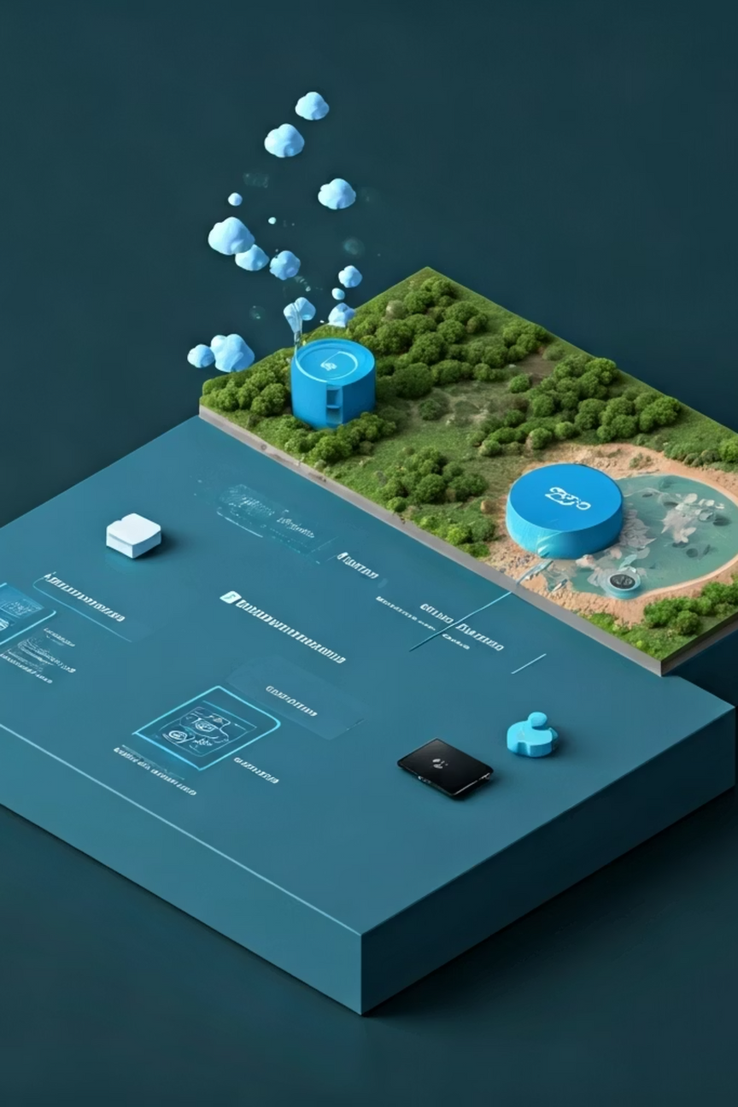

Project Prerequisites & Funding
Successful implementation of this project relies on solid technical foundations and financial backing.
Technical Prerequisites:
Cloud Infrastructure: Microsoft Azure services (IoT Hub, Stream Analytics, SQL Database, Data Lake)
IoT Device Network: Deployment of 8 sensor devices across Egypt
Development Stack: Python (for data simulation), SQL, and a dashboard framework (e.g., Power BI)
Funding & Investment:
Financial backing is essential for pilot deployment and sustained operations. Potential sources include:
Government Grants & Initiatives: Aligned with Egypt's environmental strategy
Research & Development Funds: From academic or tech innovation funds
Corporate Sponsorship & CSR: Partnerships with industries and tech companies
International Environmental Funds: Global climate organizations
This foundational support ensures successful launch, scaling, and long-term impact on Egypt's environmental health.
Notes:
7

Slide 8

IoT Hub: Monitoring 8 Regions Across Egypt
Our project leverages the power of IoT Hub to monitor critical environmental parameters across 8 distinct regions in Egypt. We have deployed 8 IoT devices, one in each region, continuously measuring temperature, humidity, and pollution levels.
These devices securely connect to Azure IoT Hub, serving as the central gateway for data collection and management. The IoT Hub facilitates:
Secure Device-to-Cloud Communication: Ensuring all environmental data is transmitted safely and reliably.
Device Management: Centralized control and monitoring of all deployed IoT sensors.
Real-time Data Streaming: Enabling immediate access to environmental metrics as they are generated.
This robust infrastructure is key to providing comprehensive environmental insights across Egypt.
Notes:
8

Slide 9

Data Generation for IoT Devices
The foundational step of our project involves simulating environmental sensor data to feed our pipeline, specifically for the 8 IoT devices deployed across Egypt's regions mentioned in the previous slide. This milestone focuses on:
Data Simulation: A Python script generates realistic temperature, humidity, and pollution data every 10 seconds for each of the 8 devices, mimicking real sensor readings from different geographical locations.
Data Ingestion: This simulated data is then efficiently sent to Azure IoT Hub and processed through Azure Stream Analytics for both real-time processing and batch analysis.
This ensures a steady stream of data for system testing and development, accurately representing the inputs from our distributed IoT network.
Notes:
9

Slide 10
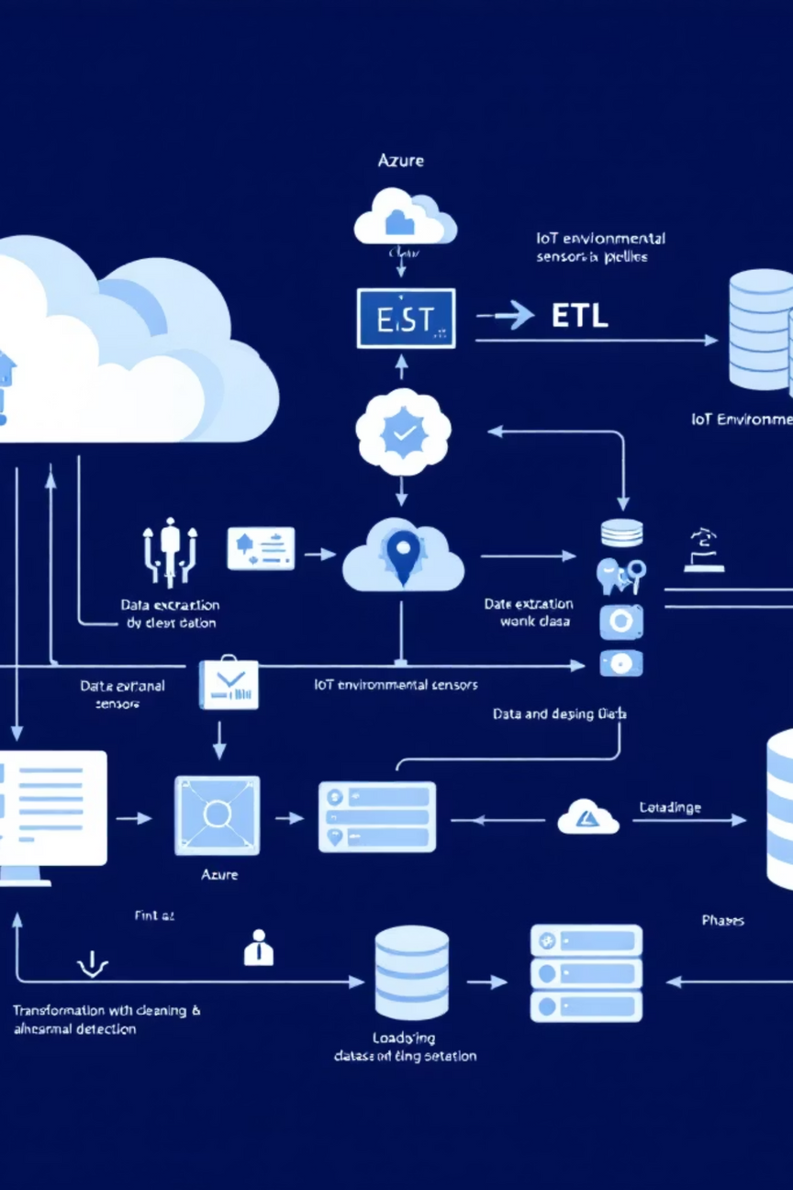
Batch Data Processing Pipeline
Our batch data pipeline is crucial for handling the historical and aggregated environmental data collected in real-time from the 8 IoT devices across Egypt's regions, ensuring accuracy and providing deeper insights. This ETL (Extract, Transform, Load) process includes:
Extraction: Gathering environmental data from the 8 IoT devices via Azure IoT Hub.
Transformation: Executing critical steps like data cleaning, anomaly detection, and calculation of essential averages to refine the dataset.
Loading: Storing the fully processed and analyzed data into a SQL database or a scalable data lake for long-term storage and accessibility
Notes:
10

Slide 11
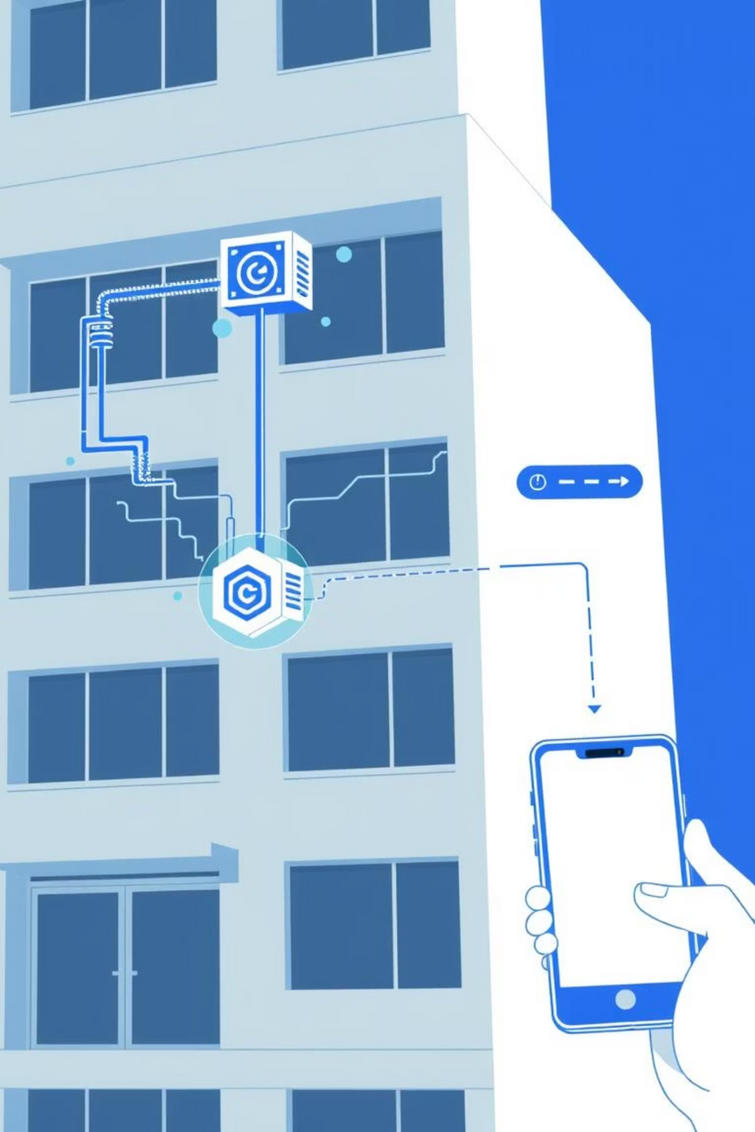
Real-Time Streaming Pipeline & Alerts
Complementing our batch processing pipeline, this real-time streaming pipeline processes live data from the same 8 IoT devices across Egypt's regions to enable immediate response to changing environmental conditions:
Live Data Processing: Utilizing Azure Stream Analytics to process incoming sensor data from the 8 IoT devices instantaneously.
Threshold Monitoring: Continuously monitoring for predefined environmental thresholds, such as elevated temperatures or humidity levels.
Automated Alerting: Triggering immediate alerts and notifications when thresholds are breached, enabling rapid intervention.
Notes:
11

Slide 12

AI-Powered Insights: Intelligent Air Quality Solutions
Our real-time IoT data pipeline integrates an advanced Large Language Model (LLM) agent, transforming raw environmental data into actionable intelligence. This AI specialist is designed to elevate our system from mere monitoring to proactive environmental management.
Specialized Data Analysis
The LLM agent excels at deeply analyzing environmental data, identifying complex patterns and correlations across temperature, humidity, and various pollution levels.
SQL Server Integration
It seamlessly connects to our centralized SQL server, accessing all processed environmental data to ensure comprehensive and accurate analysis.
Actionable Recommendations
The agent provides intelligent, context-aware solutions and actionable suggestions to improve air quality, moving beyond simple reporting.
Proactive Strategies
Examples of suggestions include optimized policy recommendations, targeted intervention strategies, and predictive insights to mitigate future pollution events.
This intelligent AI component empowers our system to not just react to environmental changes but to anticipate and proactively manage air quality challenges effectively.
Notes:
12

Slide 13
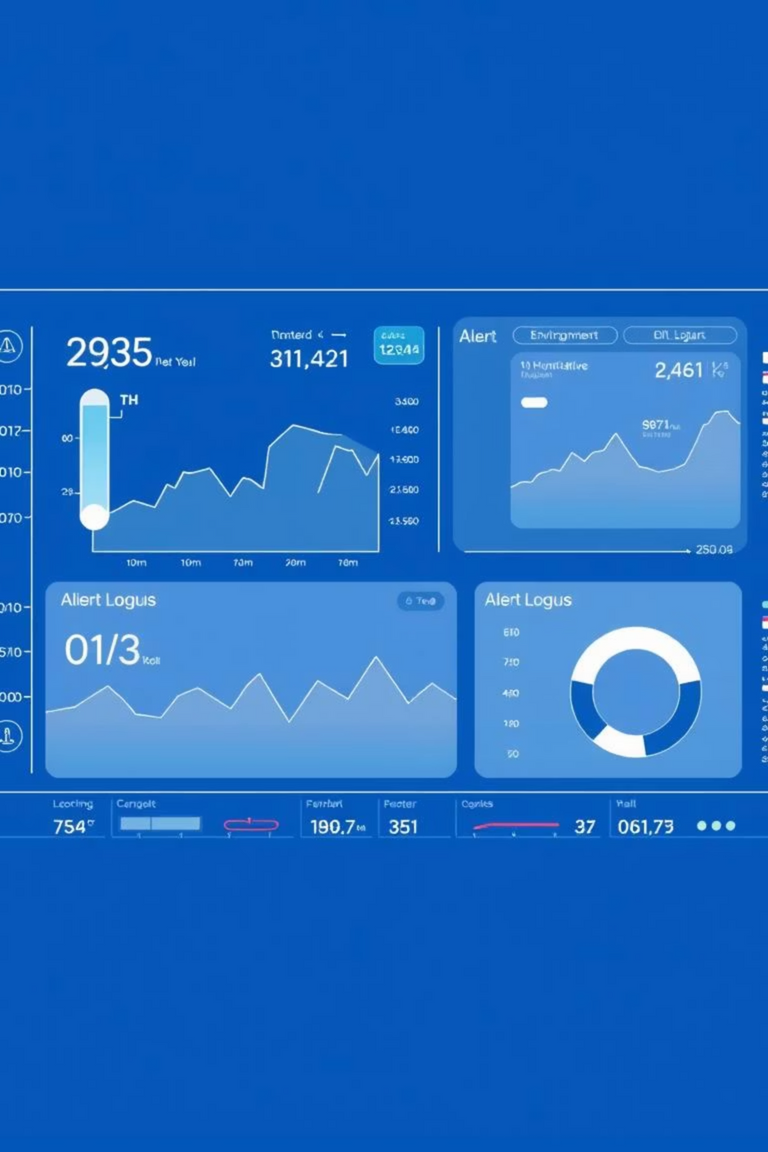
Dashboard & Final Report
The culmination of our project involves delivering a comprehensive dashboard and a final report, providing actionable insights into environmental conditions. This dashboard serves as the final visualization layer, bringing together all the processed data from the 8 IoT devices across Egypt's regions that were gathered and analyzed in the previous steps:
Interactive Dashboard: A user-friendly interface displaying real-time metrics for temperature, humidity, and pollution from the 8 IoT devices across Egypt's regions, complete with a log of all triggered alerts from both batch and streaming pipelines.
Notes:
13

Slide 14
Complete System Workflow: From Challenge to Impact
Environmental Challenge:
Air Pollution in Urban Egypt poses significant health risks, economic impact, and regulatory needs that require immediate attention.
Our AI-Powered System Response:
We address this challenge through two parallel approaches:
Technical Infrastructure: 8 IoT devices deployed across Egypt → Azure IoT Hub for data collection → Real-time processing with Stream Analytics & Alerts
Strategic Alignment: Full integration with Egypt Vision 2030 environmental goals
Processing Pipeline:
Batch ETL Pipeline: Comprehensive data cleaning and storage
AI & LLM Analysis: Advanced pattern recognition and predictive insights
Dashboard & Reports: Real-time visualization and monitoring
Actionable Intelligence Output:
Policy recommendations for government agencies
Intervention strategies for immediate response
Predictive insights for long-term planning
Positive Impact Achieved:
Cleaner Air & Better Health: Measurable reduction in pollution levels
Improved Public Health: Lower respiratory illness rates
Sustainable Development: Supporting Egypt's environmental goals
Notes:
14

Slide 15





Key Benefits of Real-Time Environmental Monitoring
Continuous Monitoring
Data-Driven Decisions
Real-time tracking enables swift intervention during hazardous environmental conditions, preventing prolonged exposure to risks.
Empowers policymakers and the public to make informed choices, fostering proactive strategies for air quality improvement.
Scalability & Adaptability
Enhanced Public Health
The system is designed for flexibility, allowing it to be easily adapted to monitor other environmental factors such as water quality or noise pollution.
Directly supports efforts to reduce health risks linked to poor air quality, promoting a healthier environment for all citizens.
Notes:
15

Slide 16
Thank You!
Thank you for your attention. This presentation covered the AI Air Quality Analysis and Environmental Monitoring System project, brought to you by the dedicated team from DEPI AI & Data Science Track: Hassan Bassiouny, Ziad Meshref, Youssef Menisy, and Malak Abdo Ramadan.
We now open the floor for any questions or discussion you may have.
Notes:
16

